Slide 1
Introduction To Ethical Hacking
By Brandon S. Keath
Sr. Security Engineer

Slide 2

Who Is This Brandon Guy Anyway?
Sr. Security Engineer at D&H Distributing
Soon to be Cyber Security Architect for Appalachia Technologies
Master’s of Cyber Security and Information Assurance(in three weeks) from Western Governor’s University
EC-Council Certified Ethical Hack & Certified Hacking Forensics Investigator
I like to Program in Python and Hack stuff!

Slide 3
Agenda
What is a Hacker?
What makes a hacker ethical
Mindset of a hacker?
Hacker Methodology
Reconnaissance
Scanning
Gaining Access
Maintaining Access
Covering Tracks
Web Hacking
OWASP Top 10
OWASP Testing Guide
Burp Suite OWASP ZAP
Web Goat, BWAPP, Juice Shop
Bug Bounty Hunter
Who Do Hackers Target?
Defense in Depth

Slide 4

What is a Hacker?
Modern Version of Hacker:
a person who uses computers to gain unauthorized access to data.
synonyms: cybercriminal, pirate, computer criminal, keylogger, keystroke logger;
Original Meaning:
Is any skilled computer expert that uses their technical knowledge to overcome a problem.

Slide 5

What is an Ethical Hacker?
A hacker who gains permission before attempting
To hack into a computer system, network, or device.

Slide 6


Mind Set of Hacker

Slide 7
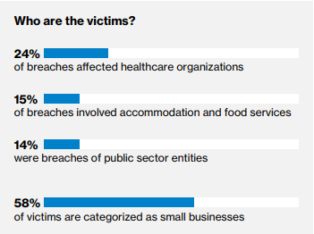
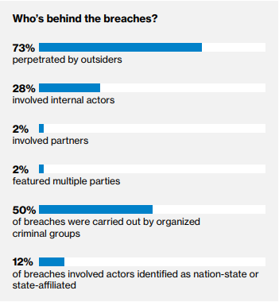
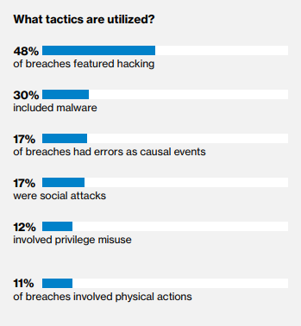
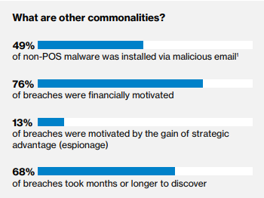
What do Hackers Target

Slide 8
Types of Cyber Security Professionals
Red
Team
Ethical Hacking
Network and Web Pen Testing
Blue
Team
Defense management
Antivirus, Encryption, Firewalls, SIEM, ETC
Purple
Team
Mix of red and blue team
Sometimes considered management or compliance related role.

Slide 9
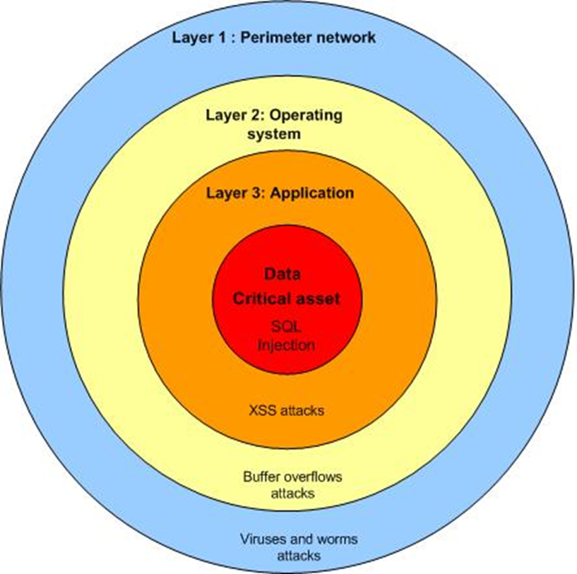

Defense In Depth

Slide 10


Reconnaissance

Slide 11
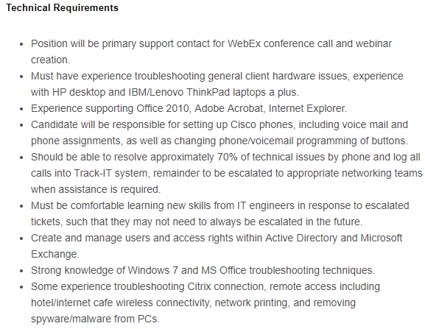
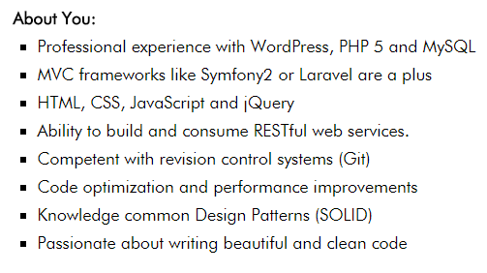
Look at Job Ad’s

Slide 12
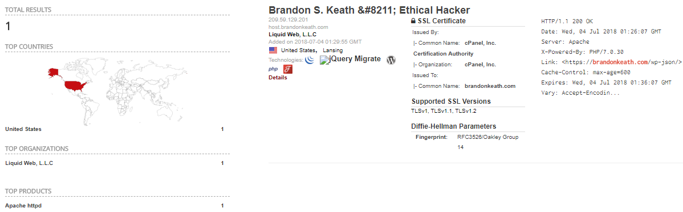
Shodan.io

Slide 13
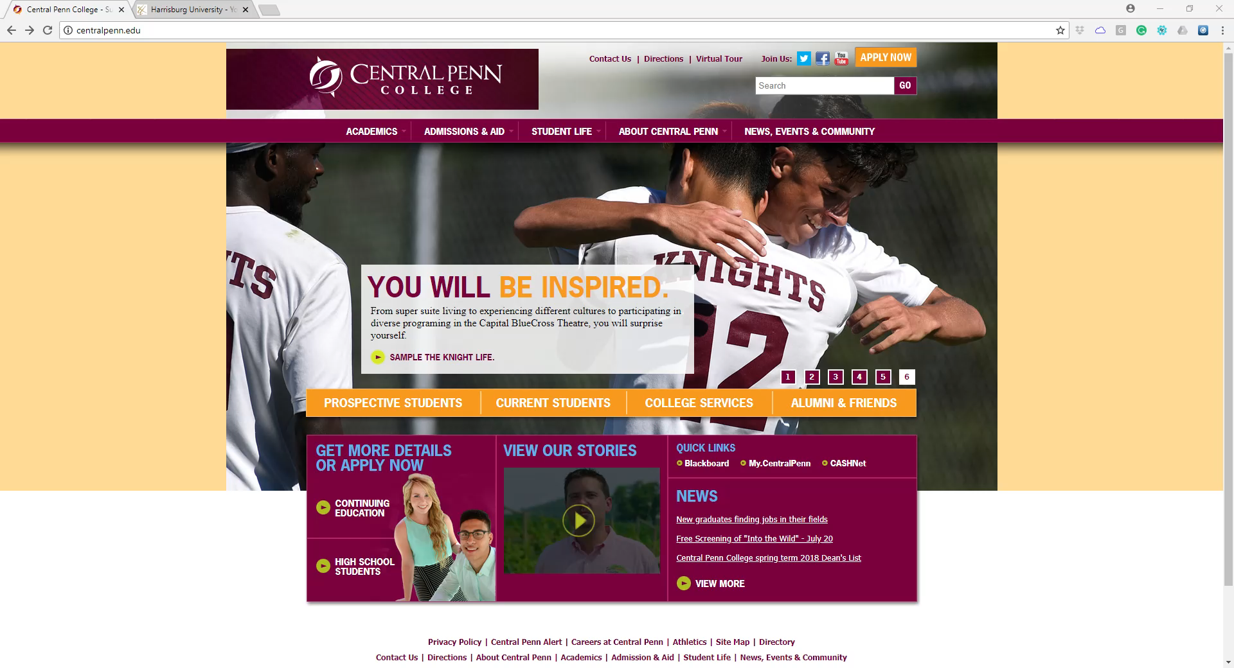
Recon Demo #1

Slide 14
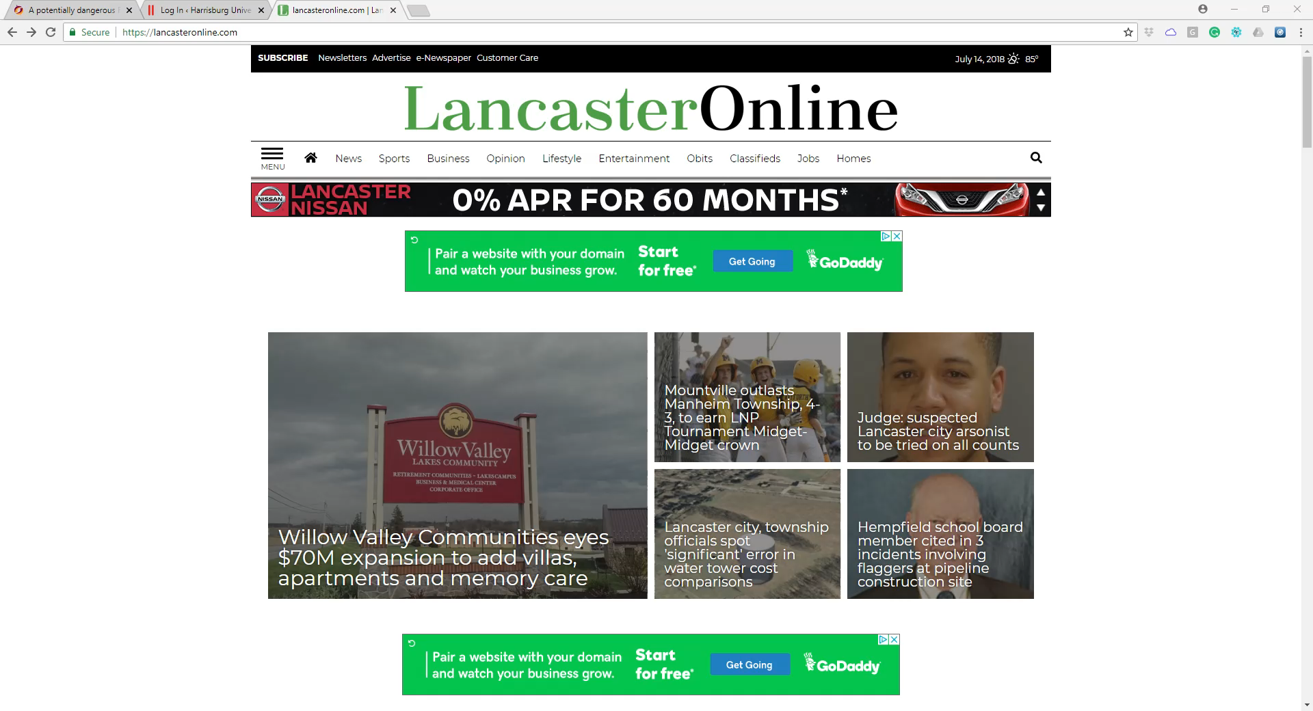
Recon Demo #2

Slide 15

Review What is Reconnaissance

Slide 16


Scanning

Slide 17
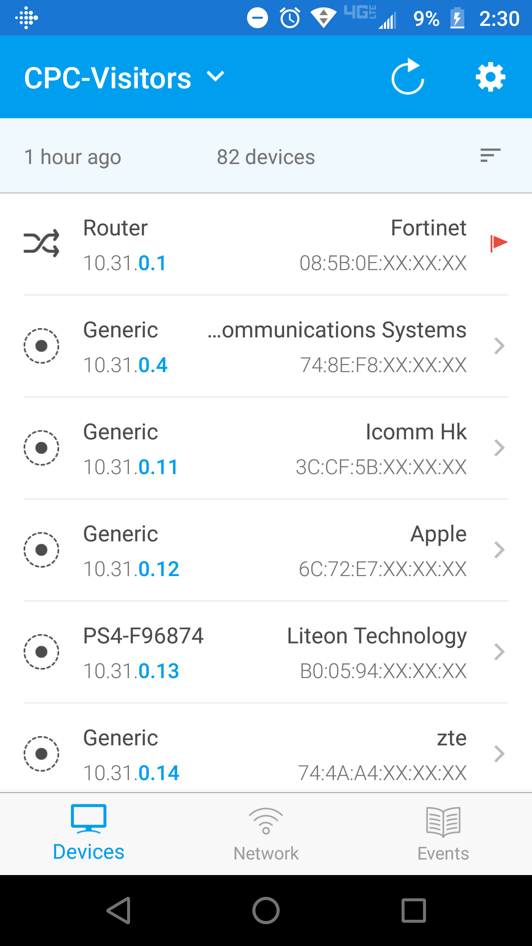
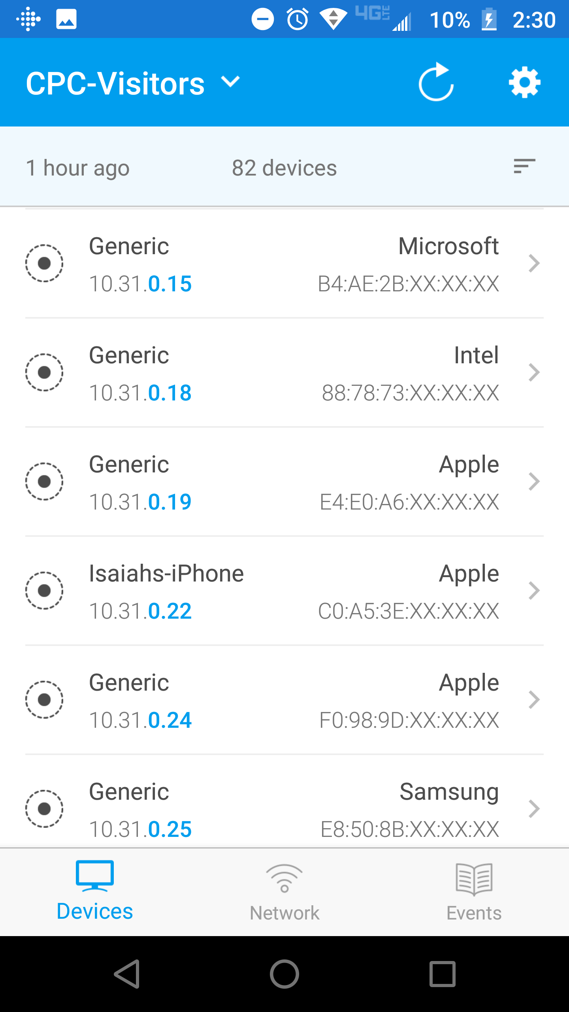
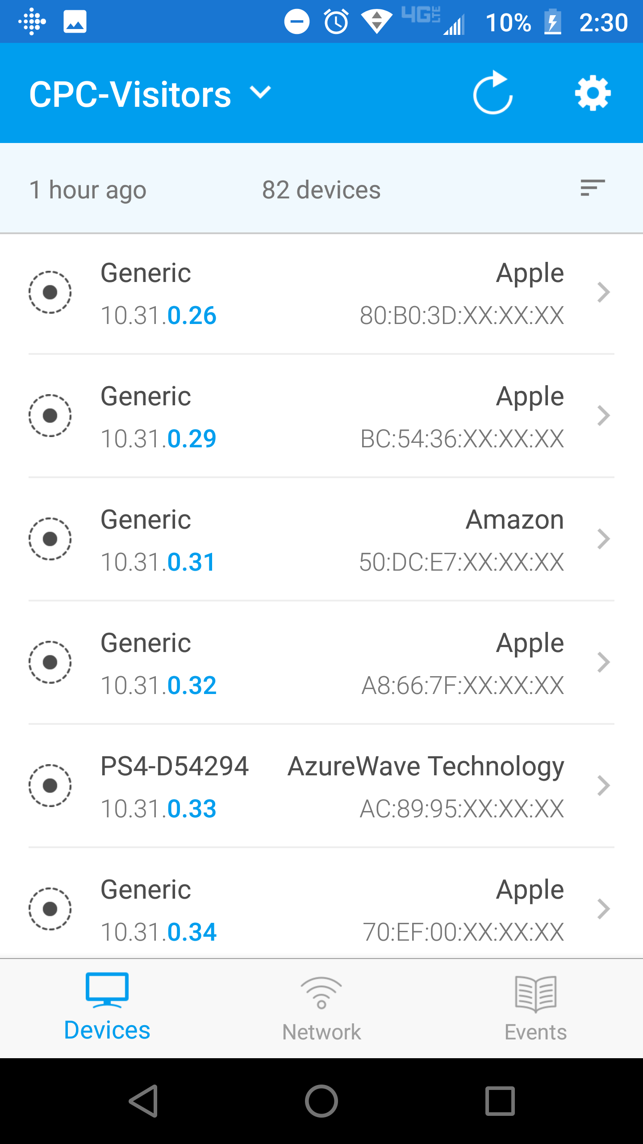
Scanning with Fing

Slide 18
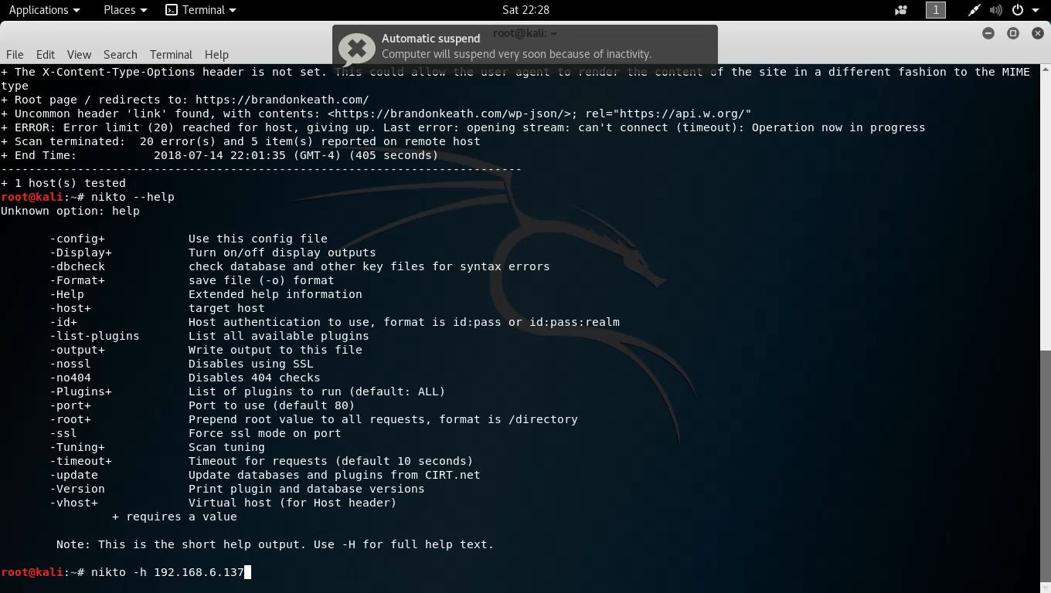
Scanning Demo Nikto

Slide 19
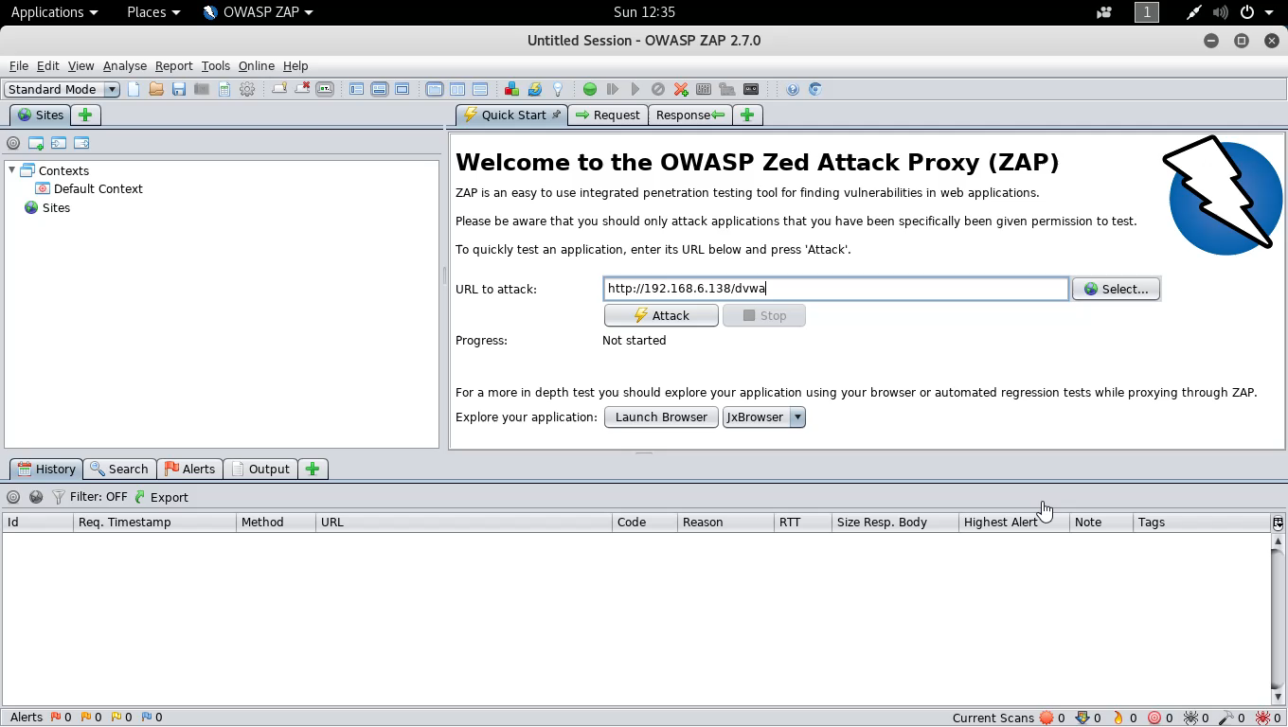
Scan Demo 2

Slide 20

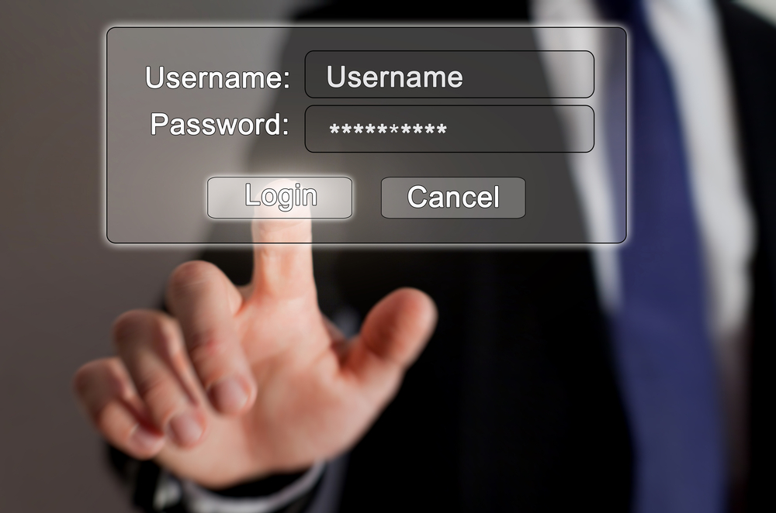
Gaining Access

Slide 21
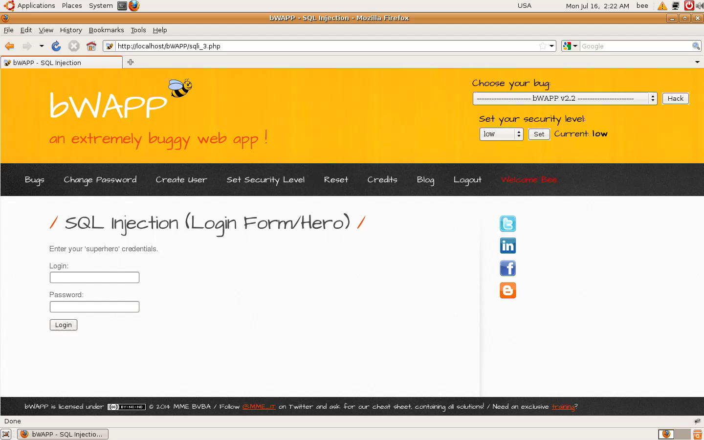
Gaining Access with SQL Injection

Slide 22
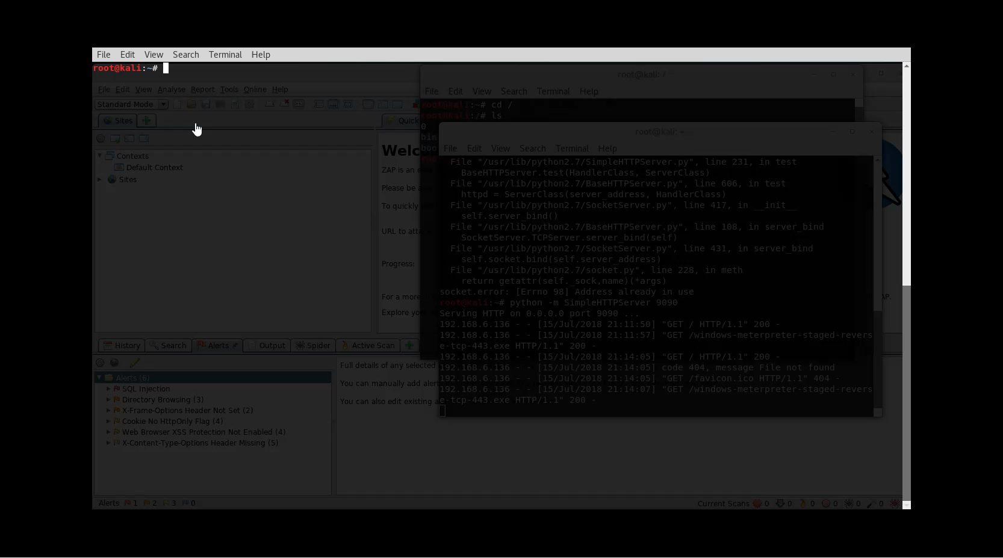
Gaining Access with .EXE File

Slide 23
Maintaining Access
Install additional malware/backdoors
Compromise Other Systems
Begin to download sensitive information

Slide 24
Covering Tracks
Delete or Modify log files
Remove all traces of malware on system
Decommission system or malware used for hack.

Slide 25

Web Hacking

Slide 26
What is Vulnerability/Pen Testing?
Web Vulnerability Scanning:
Is a process for identifying potential web application
vulnerabilities within web application code.
Web Penetration Testing
Is a process for verifying potential vulnerabilities using actual exploits and tests to determine if the vulnerability is a false positive.

Slide 27
Where do I start and what really is a secure web application?
OWASP provides a free Web Application security testing framework providing a foundation for testing: OWASP Testing Guide 4.0
OWASP Provides a detailed definition of what a “secure” web application is in their Application Security Verification Standard (ASVSP)
BWAPP provides an insecure web application that you can practice web hacking on.

Slide 28
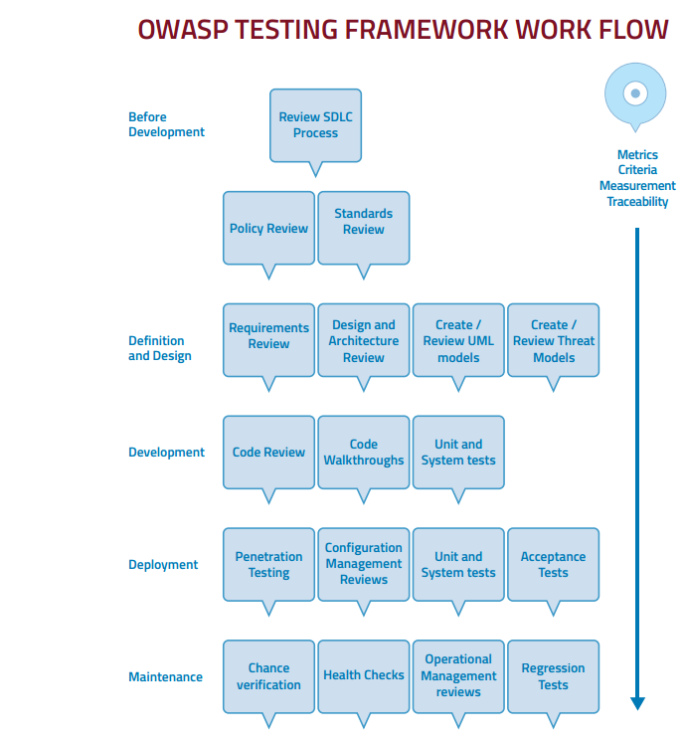
SDLC Test Framework

Slide 29
What do we test for?
OWASP releases a Top 10 that details information OWASP Top 10
OWASP TOP 10
A1 Injection | A2 Broken Authentication
A3 Sensitive Data Exposure | A4 XML External Entities
A5 Broken Access Control | A6 Security Misconfiguration
A7 Cross Site Scripting | A8 Insecure Deserialization
A9 Using Known Vulnerable Components | A10 Insufficient Logging & Monitoring

Slide 30
A1 Injection
SQL Injection is the most common kind of injection vulnerability.
The main defense to this attack vector is using parameterized queries.
Object Relational Mappers(ORMS) can help prevent most types of SQL injection.
Using stored procedures can also prevent this vulnerability.
Better sanitizing of user input is another method that will help prevent injection based vulnerabilities.

Slide 31
A2 Broken Authentication
Authentication should be simple, centralized, and standardized
Beware hackers taking advantage of forget password logic, use two factor where possible and feasible within your web application.
Use standardized security encryption and user management frameworks.

Slide 32
A3 Sensitive Data Exposure
Use HTTPS within all applications to encrypt data.
Encrypt Sensitive data in your database.
Test for authorized access to sensitive data or accidental data exposure.

Slide 33
A4 XML External Entities (XXE)
The application accepts XML directly or XML uploads,
especially from untrusted sources, or inserts untrusted data into
XML documents, which is then parsed by an XML processor.
To avoid:
Whenever possible, use less complex data formats such as JSON, and avoiding serialization of sensitive data.
Patch or upgrade all XML processors and libraries in use by the application or on the underlying operating system. Use dependency checkers. Update SOAP to SOAP 1.2 or higher.
Disable XML external entity and DTD processing in all XML parsers in the application, as per the OWASP Cheat Sheet 'XXE Prevention'.
Implement positive ("whitelisting") server-side input validation, filtering, or sanitization to prevent hostile data within XML documents, headers, or nodes

Slide 34
A5 Broken Access Control
Bypassing access control by modifying the URL or internal application state
Example:
https://MySecureWebsite/sensitive-account-details?id=304

Slide 35
A6 Security Misconfigurations
Examples of security misconfigurations can include:
Passwords not encrypted in configuration files.
Security issues revealed in source code such as passwords or configuration a hacker could exploit.
Not changing credentials in production from development environment.
IIS not being configured properly
Vulnerabilities on security configuration of Windows or Linux hosting server.

Slide 36
A7 Cross Site Scripting
Cross-Site scripting happens anytime raw data is sent from an attacker to an innocent user’s browser. Often in the form of JavaScript that will end up running in a user browser.
Often forces users to other sites, steals user’s session, sensitive data, rewrites web page, and redirects user to phishing or malware site.
To prevent cross-site scripting use Content Security Policy

Slide 37
What is content security policy?
Content Security Policy or CSP is an HTTP header that allows for specifically whitelisting what resources(like JavaScript, images, etc.) are allowed to be loaded and executed on a webpage.
You can add Content-Security-Policy to your web.config:
<add name="Content-Security-Policy" value="default-src 'self';" />

Slide 38
A8 Insecure Deserialization
Do not accept serialized objects from untrusted sources or to use serialization mediums that only permit primitive data types.
Monitor deserialization, and alert on suspicious deserialization

Slide 39
A9 Using Components with Known Vulnerabilities
Do not use components that have known vulnerabilities
Use https://www.exploit-db.com/ or https://nvd.nist.gov/
Upgrade third party components and patch often.

Slide 40
A10 Insufficient Logging & Monitoring
Ensure logging is turned on for applications.
Ensure that logging is built into the application where tampering may be evident.
Centralize logs where possible and review as needed.

Slide 41
Security Tools
Kali Linux - https://www.kali.org/downloads/
Metasploit - https://www.offensive-security.com/metasploit-unleashed/
OWASP ZAP - https://github.com/zaproxy/zaproxy/wiki/Downloads
Burp Suite - https://portswigger.net/burp
Archery - https://archerysec.info/

Slide 42
BWAPP and Webgoat Security Training
WebGoat is an open source security training tool.
BWAPP is another tool that can be used for application security training.
HackSplaining is a great resource for learning about web exploits:

Slide 43
OWASP ZAP
OWASP ZAP is an easy to use integrated pen testing tool for finding vulnerabilities in web applications.
Zap provides automated scanners and a set of tools for manually finding vulnerabilities.
Zap is a great tool for most open source security testing needs.

Slide 44
Burp Suite
Burp Suite is a commercial tool that includes the following:
Automated crawl and scan of 100 vulnerabilities
Intercept browser traffic as a man in the middle proxy
Automate custom attacks using Burp Intruder
Extensible with Python and Java Programming plugins
Burp is considered the standard for web penetration testing and costs $350 for a commercial license.

Slide 45
BWAPP Live Example
Demo of Burp intercepting Traffic

Slide 46
Bug Bounty Hunting?
Application Security Testing in Production!
Bug bounty hunters earn between $10,000-$500,000/year as hunters
www.hackerone.com
www.bugcrowd.com
https://www.hacker101.com/

Slide 47
Open Questions and Answers
Visit my terrible blog at www.brandonkeath.com for security updates.
Check out http://pahackers.com to stay up to date for new ethical hacking meet ups and events in the local area.

